Slide 1
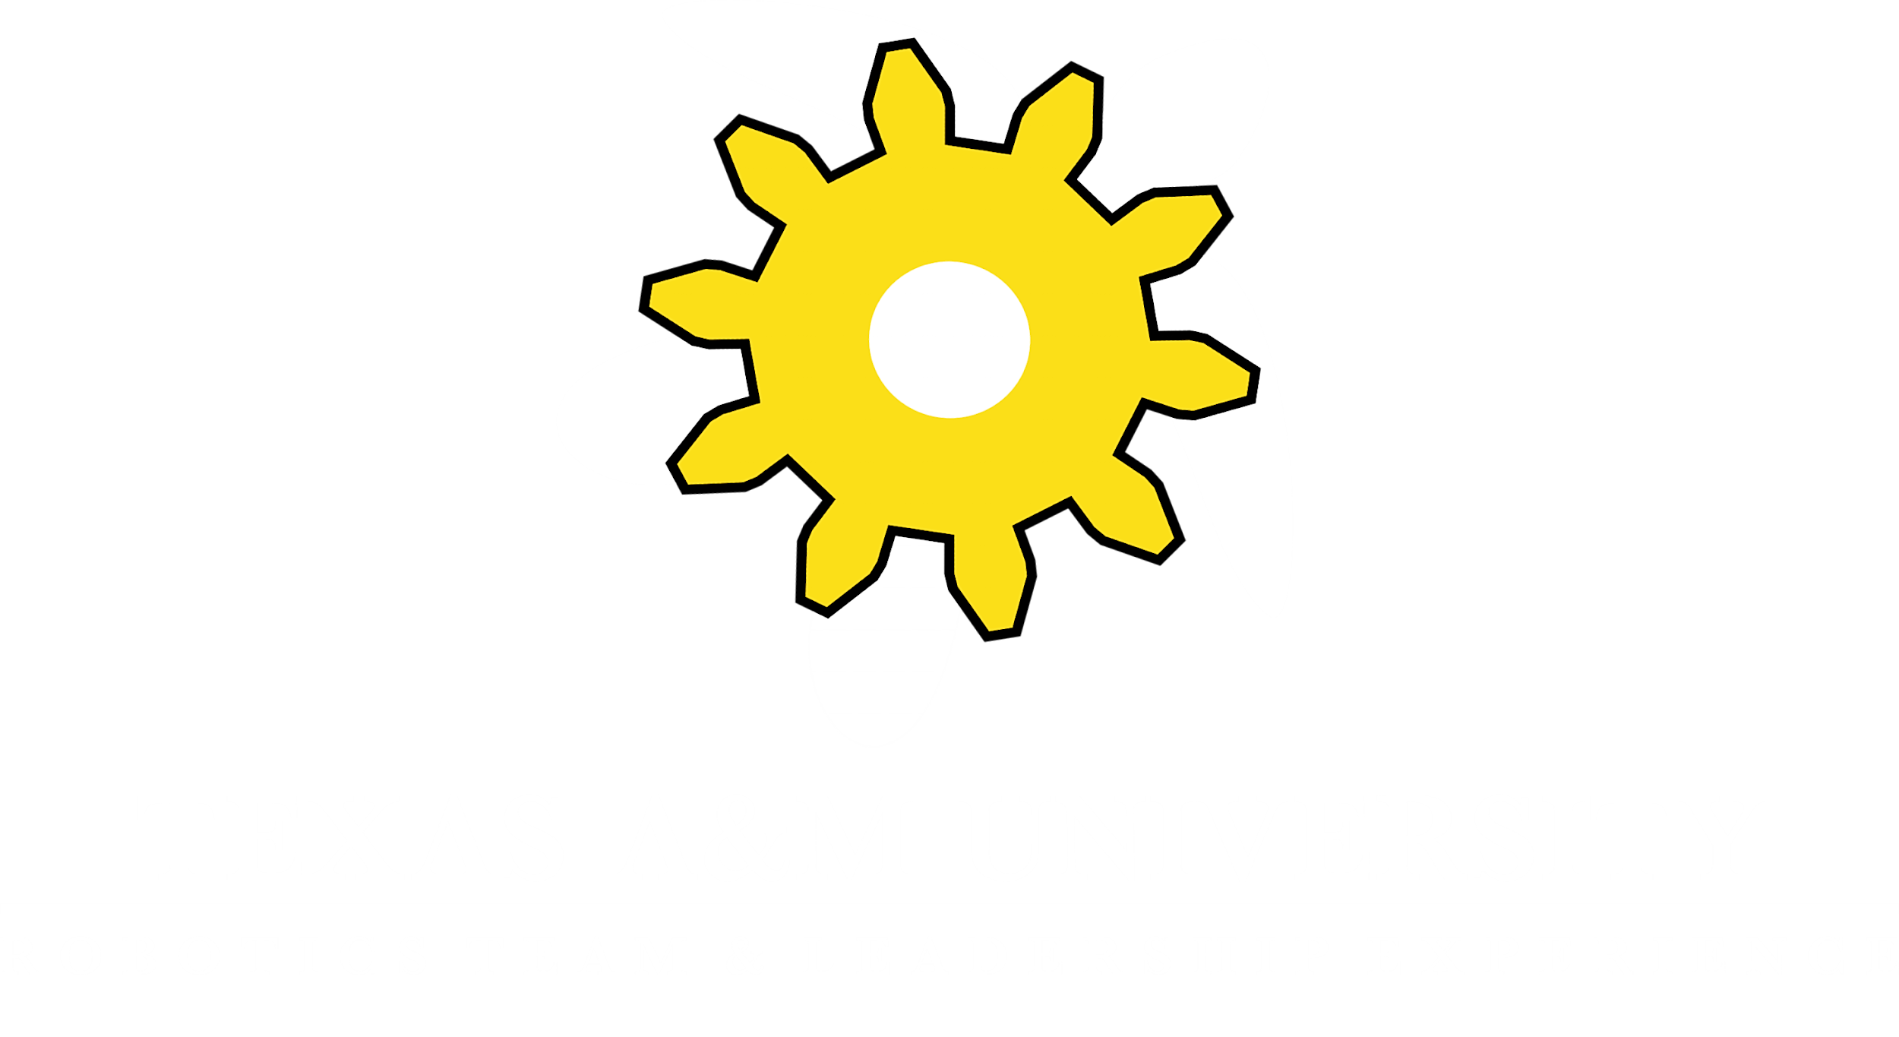

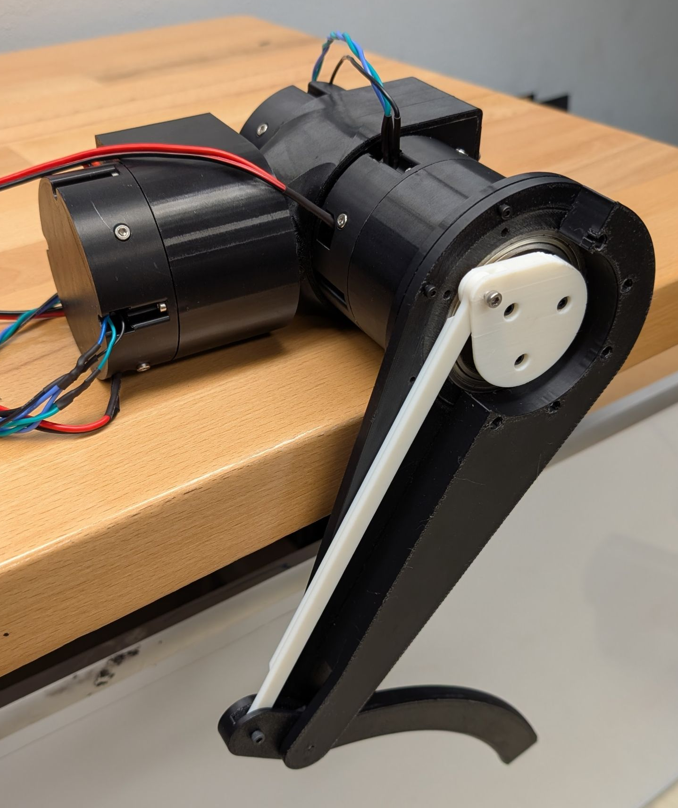
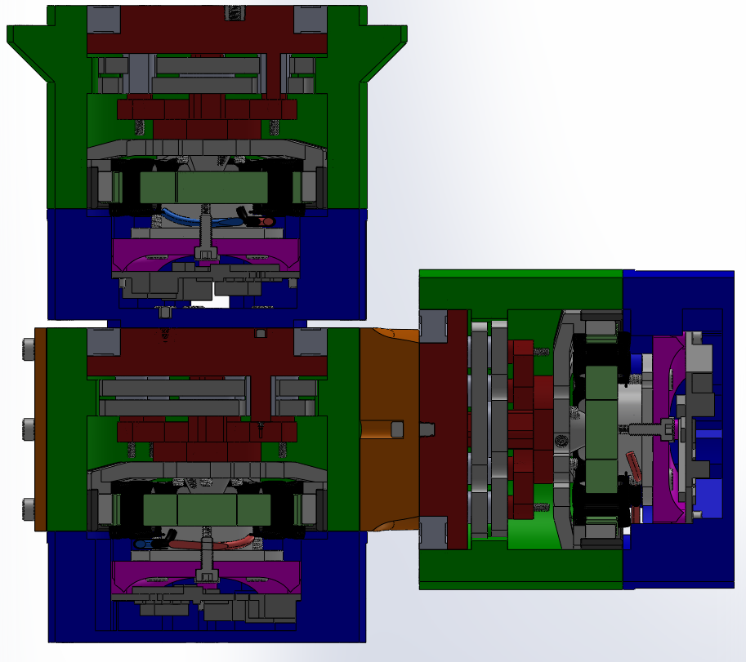
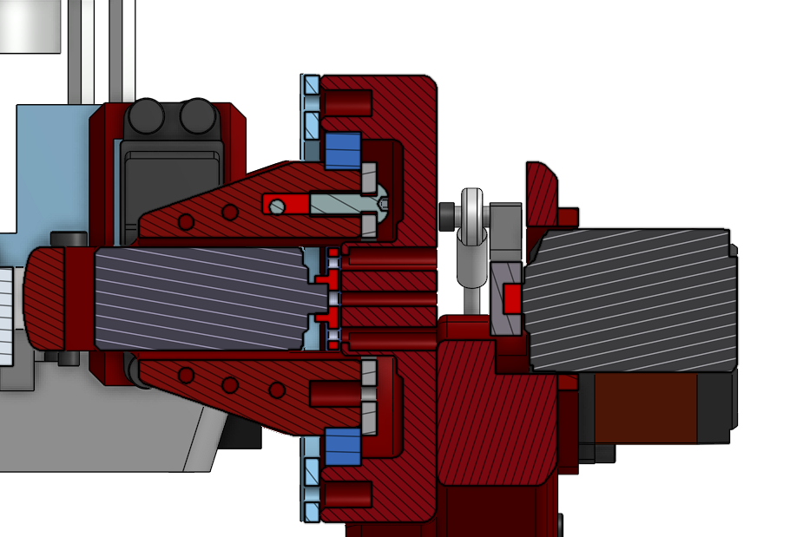
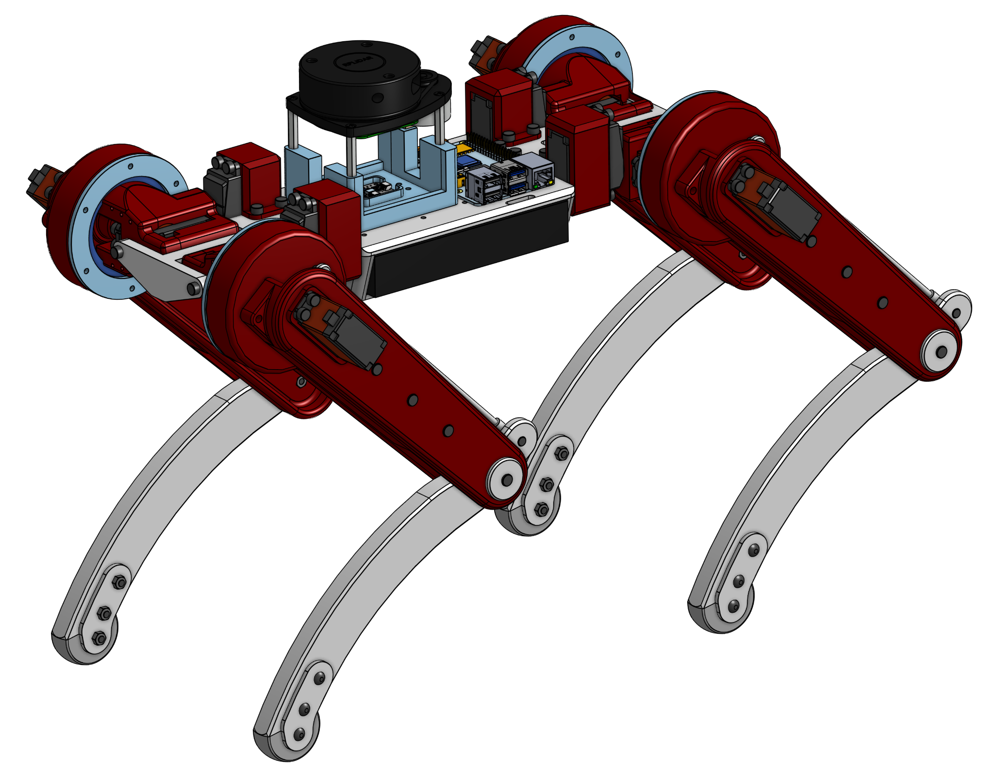
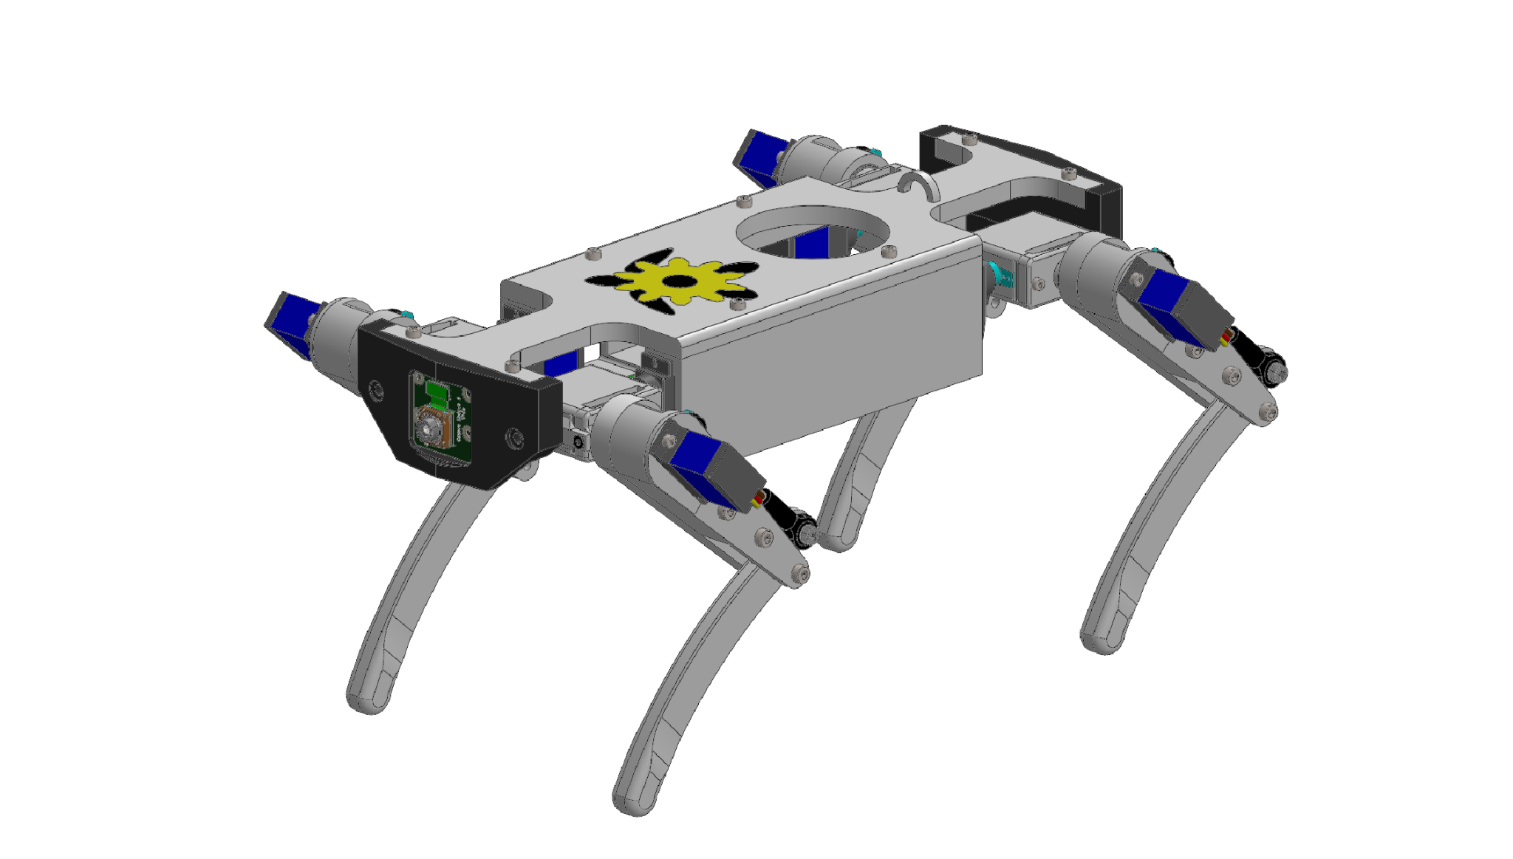
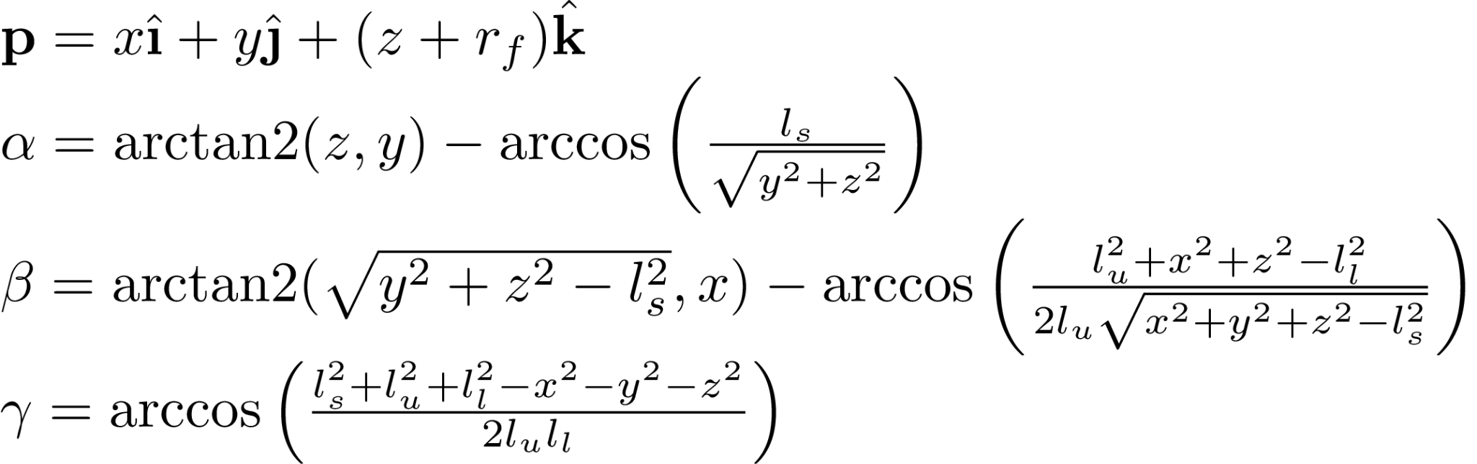
TURTLE Quadruped Project (QUAD)
Project Lead: Ian Lansdowne
Members: Kalen Jaroszewski, Eddy Silva, Jonathan Foltyn, Oscar Dominguez,
Micah Guttman, Shreyas Kannanganat, Aarathi Devakumar, Madden Schoener
Project Statement
Legged robots are more agile and adaptable than robots using other forms of locomotion. The purpose of this project is to design and manufacture a robot capable of balancing and maneuvering on four legs to better understand the capabilities of walking robots.
Previous Models
QUAD V1
The first revision of the QUAD was designed to 3 main joints on each leg: an upper and lower leg joint, and a shoulder to enhance maneuverability. The robot uses a tie rod to actuate the lower leg, which allows the actuator to reside in the upper leg and lowers the leg’s inertia. Silicone molded feet were chosen to increase grip and prevent slipping on smooth surfaces. The robot is driven by a Raspberry Pi 4 computer and uses an offboard PWM driver to control all leg motors. Additionally, an IMU and LiDAR sensor were added to experiment with mapping and walking on uneven terrains.
QUAD V2
Drawing from the QUAD V1 and Mini QUAD models, several improvements were implemented on the QUAD V2. Ensuring the robot can support more than its own weight was a top priority. To address this, the maximum torque output was increased by using more powerful brushless motors to drive a custom 19:1 cycloidal gearbox. The gearbox was inspired by designs from Aaed Musa and James Bruton to increase the motor torque in a small form factor with a backdrivable output. The motors are mj5208s driven with the moteus-c1 motor controller.
A test stand is in the process of being constructed to test one leg of the robot before a chassis is developed. The goal is to produce a walking motion with the leg, and develop a torque controller for the leg joints. The leg design, shown in figure 5, was assembled and work will begin on developing software for the joints.
Approach
Robotic quadrupeds are not a new concept by any means. This project has drawn heavy inspiration from other quadrupedal robots including Boston Dynamics’ Spot, MIT’s Mini Cheetah, James Bruton’s openDog V3, and Ian Lansdowne’s initial prototype. To create a working robot, the team started with robot dimensions similar to the Mini Cheetah, known as QUAD V1. Upon realizing the difficulty of testing on a large and expensive robot, a smaller version was created in order to serve as a software testbed. Most recently, V2 was completed taking the shortcomings from V1 and the framework of mini and improved upon them. A cycloidal drive was also designed and tested to be used in a future iteration.
Figure 2. QUAD V1 Shoulder Cross Section.
Figure 5. Assembled QUAD V2 Leg
Mini QUAD V1
As a scaled version of the QUAD V1, Mini QUAD V1 was created to demonstrate the walking capabilities of QUAD V1 at a smaller and more maintainable scale. The robot has a similar design to the QUAD V1, and serves as a testbed for software development.
Figure 4. Section View of Cycloidal Actuator CAD model.
Future Goals
Over the next semester, the QUAD V2 robot will be completed by designing a chassis, power system, and control system for the robot. The control system will involve finding an equation of motion based on the inverse kinematics for the leg in figure 6, which were derived for QUAD V1.
The cross-sectional view of one leg module is shown in figure 4. The three motors driving the lower leg (top), upper leg (bottom left), and shoulder (bottom right) are packed in the upper body to reduce the inertia of the legs. The design of the leg module is similar to both previous models, where the lower leg is actuated by a tendon between the motor and knee. The tendon of this model was designed to be made from plastic, and is a straight, flat rod to reduce stress concentrations. To reduce the material and mass of the robot, one point of support was used at the base of the leg. The team determined that the moment on the leg should be relatively low, and the gearbox acts as both supports on the drive shaft.
Figure 6. Inverse Kinematic Equations.
Figure 1. CAD model of QUAD V1.
Figure 3. CAD model of Mini QUAD V1.

